Slide 1
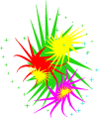
Firework Poem
Booming bangs are very loud,
Sparkling stars jump in the sky,
Racing rockets zoom in the air,
Rainbow rings spin,
Spitting sparklers spell our name.
by Lily

